Slide 1

Weather TODAY
Subject: Project-2
Submitted in partial fulfilment of the required of the degree of
Master In Computer Application(MCA)
Biju Patnaik University Of Technology
Department of Master In Computer Application
Gandhi Institute For Technology(GIFT) ,Bhubaneswar
Name of the student | Registration no.
Chinmayee Sahoo | 2305298060
Purnima Sahoo | 2305298136
Prof. Priyabrata Nayak
Project Guide
Presented by: Chinmayee Sahoo ,
: Purnima Sahoo

Slide 2
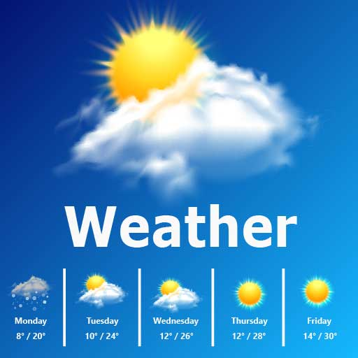
AGENDA :
ABSTRACT
MOTIVATIONN
Introduction
OBJECTIVES
Hardware and software specification
RESULTS
SCOPE OF THE PROJECT
CONCLUSION
REFERENCE

Slide 3
ABSTRACT :
The weather app project aims to develop a web-based application using JavaScript that allows users to check the current weather conditions for a specific location. The project leverages a weather API service such as OpenWeatherMap to fetch real-time weather data.
The app's architecture involves HTML for the user interface, CSS for styling, and JavaScript for functionality. Users input a location through a text input field, triggering a JavaScript function to fetch weather data from the API using XMLHttpRequest or the fetch API.
Upon receiving the weather data, the JavaScript code parses the JSON response and dynamically updates the DOM to display relevant weather information such as temperature, description, and location. Error handling is implemented to manage cases of failed API requests or invalid user inputs.
Through this project, users gain practical experience in web development, API integration, and asynchronous JavaScript programming while providing a convenient tool for accessing weather information.

Slide 4
MOTIVATION
Real-time updates: Web technology enables real-time weather updates, allowing users to access current weather conditions and forecasts instantly.
Global accessibility: Web-based weather detection makes weather information accessible from anywhere in the world, benefiting travelers, researchers, and individuals worldwide.
Personalization: Web technology allows for personalized weather forecasts based on user location, preferences, and needs.

Slide 5
Weather detection is the process of monitoring and predicting weather conditions, enabling individuals and organizations to make informed decisions and take necessary precautions. With the advancement of technology, weather detection has become more accurate, efficient, and accessible. Web-based weather detection, in particular, has revolutionized the way we access and utilize weather information, providing real-time updates, personalized forecasts, and visual representations of weather data. web-based weather detection plays a vital role in providing timely and reliable weather information, empowering individuals and communities to prepare, respond, and adapt to various weather conditions."
Introduction

Slide 6
OBJECTIVES
Accurate Forecasting: Provide timely and accurate weather forecasts to help individuals and organizations make informed decisions.
Climate Change Research: Contribute to climate change research by collecting and analyzing long-term weather data.
Public Safety: Enhance public safety by providing weather information for outdoor activities, events, and emergency response planning.
Environmental Monitoring: Monitor weather patterns to understand and mitigate the impact of weather on the environment.

Slide 7
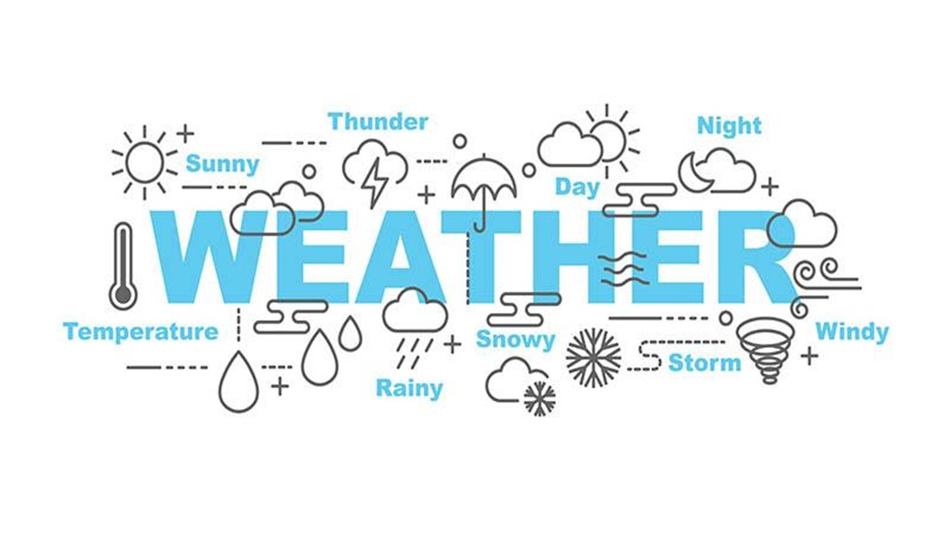
Hardware and software specification
Programming languages :
HTML
CSS
JAVA SCRIPT

Slide 8

FORMAT :
WEATHER TODAY
HOME
ABOUT
CONTACT
Bhubaneswar
24.12 Cel
Presure:1014 | Humidity:78

Slide 9

ABOUT-PAGE
WEATHER TODAY
ABOUT
WEATHER TODAY
Backend
Frontend

Slide 10
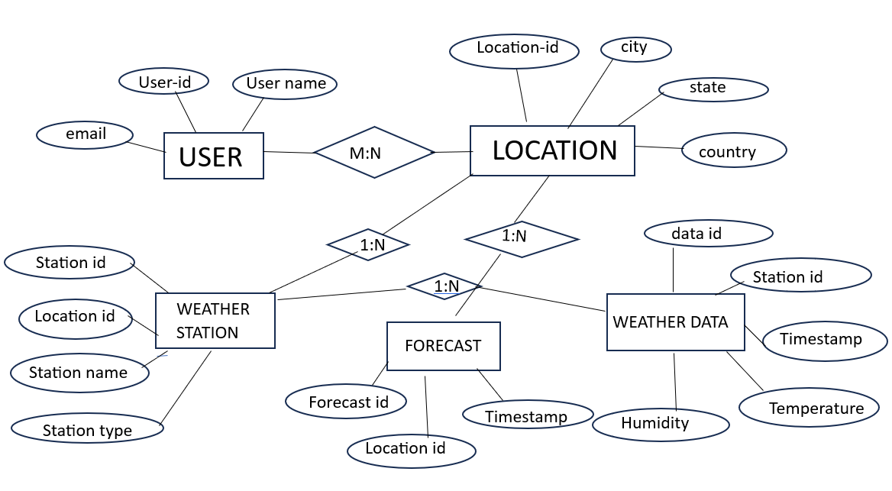
ER DIAGRAM :

Slide 11
DATA FLOW DIAGRAM :

Slide 12
Result :
Accurate Weather Data
Your system successfully fetches and displays current weather conditions, including temperature, humidity, wind speed, and weather descriptions, for a given location.
Real-Time Weather Updates
Your system updates weather data in real-time, allowing users to stay informed about changing weather conditions.

Slide 13
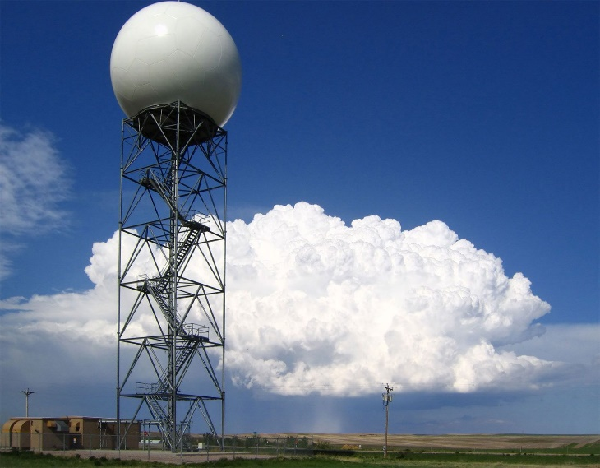
Scope of the project
Functional Requirements: - Display current weather conditions (temperature, humidity, air pressure)
User Interface Requirements: - User-friendly and intuitive interface
Technical Requirements: - API integration with a weather service provider (e.g., OpenWeatherMap) - JavaScript, HTML, and CSS for front-end development - Potential use of frameworks like React, - Back-end development with Node.js,email.js
4. Performance Requirements: - Fast and accurate weather data retrieval

Slide 14
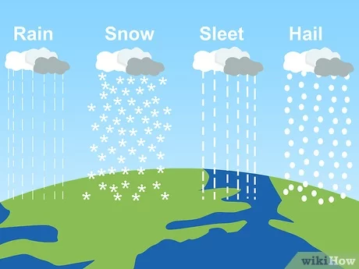
conclusion
The weather detection system project has successfully achieved its objectives, providing a functional and user-friendly platform for users to access current weather conditions and forecasts. The system's key features, including real-time updates, geolocation support, and weather alerts, demonstrate its potential to be a valuable tool for individuals and organizations alike.

Slide 15
reference
National Oceanic and Atmospheric Administration. Weather.gov. Retrieved from https://www.weather.gov/
World Meteorological Organization. Real-time Weather Data. Retrieved from https://public.wmo.int/en
Weather Underground . Weather API. Retrieved from https://www.wunderground.com/weather/api

Slide 16
Works Cited
List the resources you used for your research.

